Slide 1
Employee Well Being
Covid Era

Slide 2
Why?
Employee + Safety + Healthy = Productivity
Increase Confidence = Increase Revenue

Slide 3
Technology
Office 365 E5 license as booking.Microsoft.com – Team Event
Position of Sitting or standing/Social Distancing notification - AI
Intelligent Edge

Slide 4
Flow
Book schedule ahead in advance
Stage slots based on facility and occupancy count
Once the schedule time customer walks to facility
Facility might have other customers and employees
Monitor Social Distancing and Alert User

Slide 5
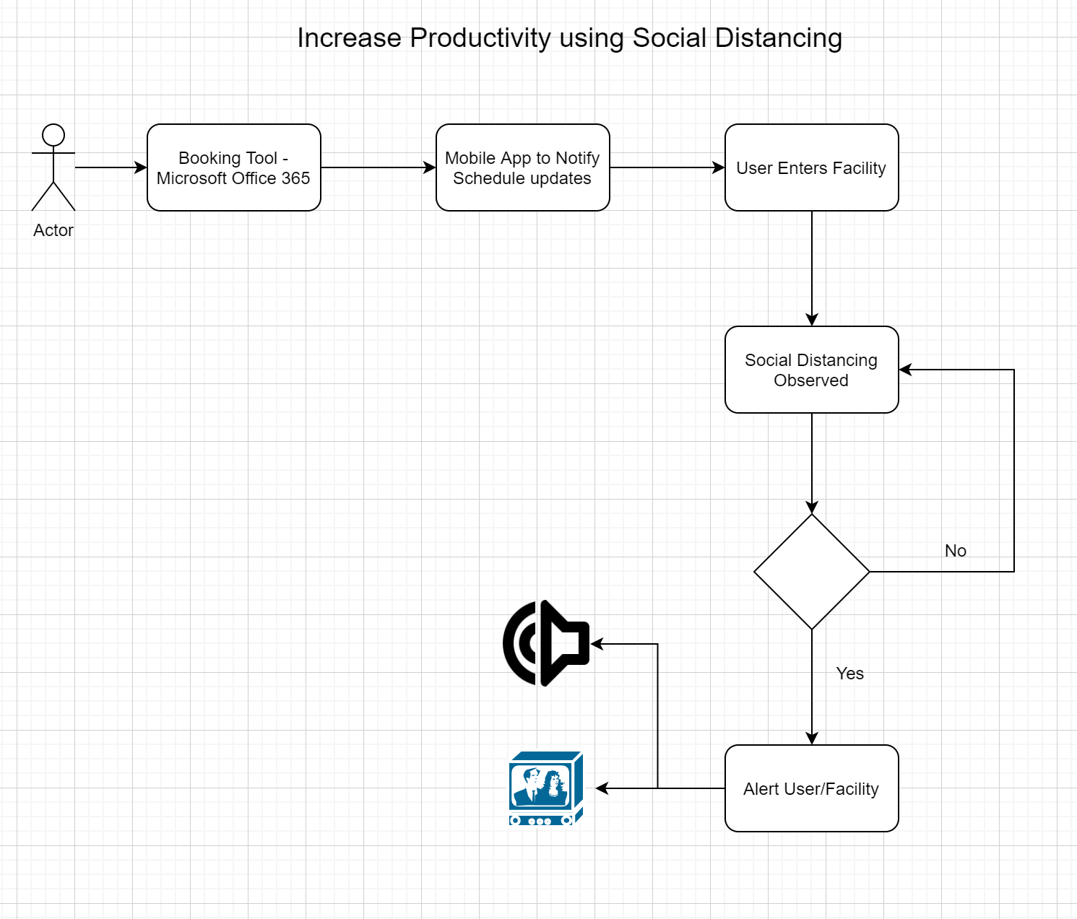
Process Flow

Slide 6
To do
Brainstorm Ideas
Wireframes or brainstorm diagrams
Whiteboard and Architecture
Form Teams
Assign Responsibilities
Project Plan – what can be done for 3 days
Recurring meeting to discuss progress
Measurements

Slide 7
Outcomes
Reference Architecture
PoC
Design document for PoC

